Slide 1
PJ Site Overview
A Brief Look At the Site and The Experimental Treatments

Slide 2
Sevilleta PJ Site
12 Plots (1000m² with treatments extending ~5m beyond each side of plot to act as a buffer)
Intensive and non-intensive physiology plots
  1 intensive plot/treatment, 2 non-intensive plots/treatment
4 Treatments
  Irrigation
  Drought
  Cover-control
  Ambient

Slide 3
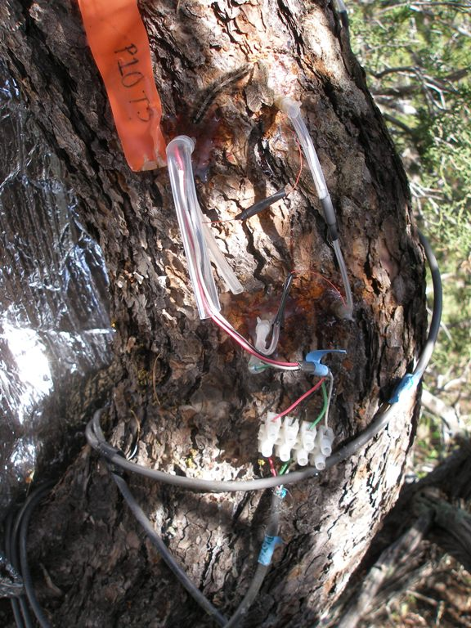
Intensive
Physiology

Slide 4
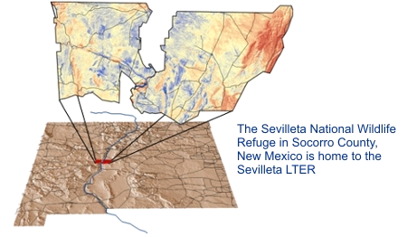
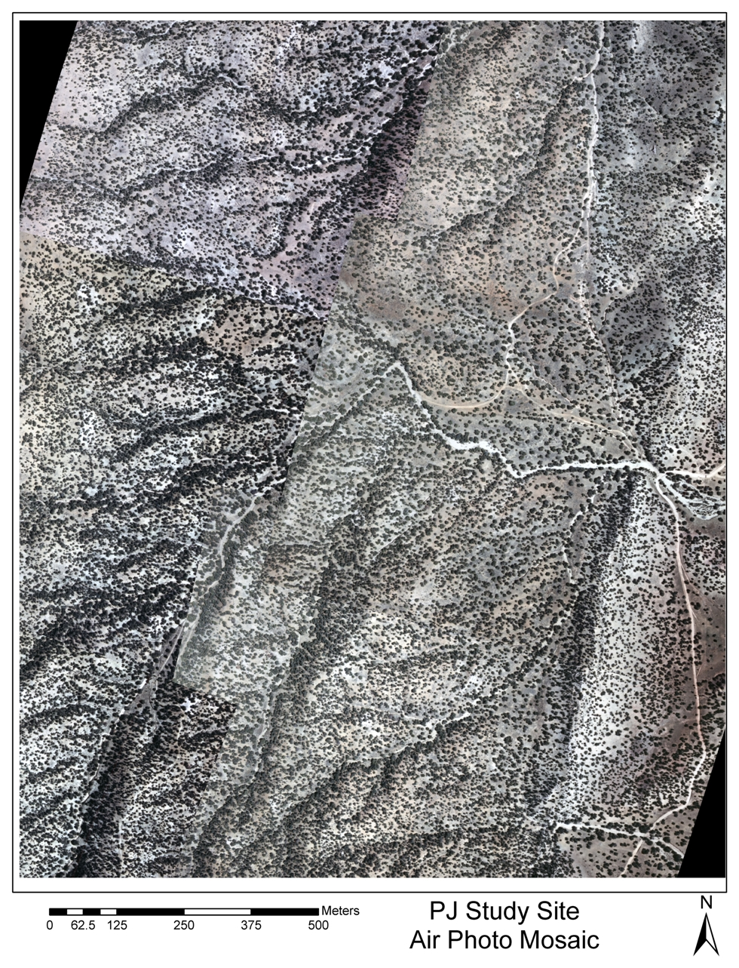
piñon and juniper woodlands at the Sevilleta-LTER (NM)
Albuquerque
(You Are Here)
Notes:
Since you are looking to cut a bit of time, I moved the climate data for the Sev to this slide, AND I moved this slide forward in the presentation. My thinking was that the flow of talk could go, pines are dying (slide 2); climate is getting worse, especially in NM (slide 3); therefore, here is where we will study pine death, and here is the most recent climate from this site

Slide 5
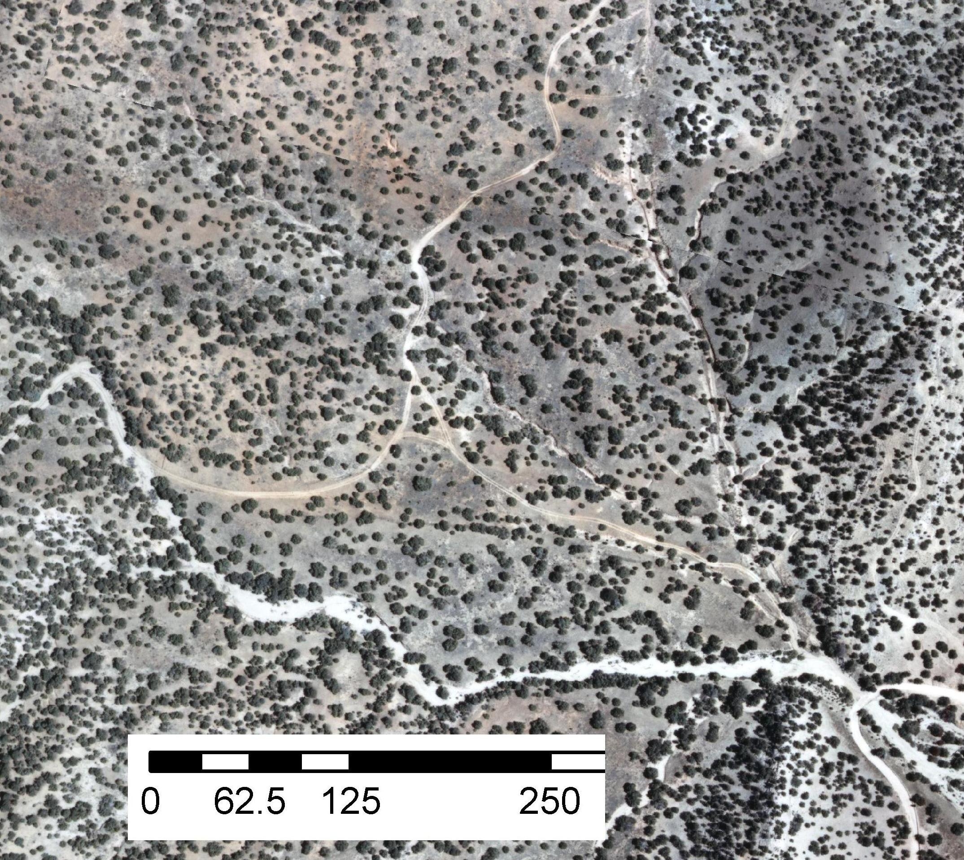
7 C-C
8 A
N
5 H2O
6 Drt
9 H2O
11 C-C
12 A
10 Drt
4 A
1 H2O
3 C-C
2 Drt
meters

Slide 6
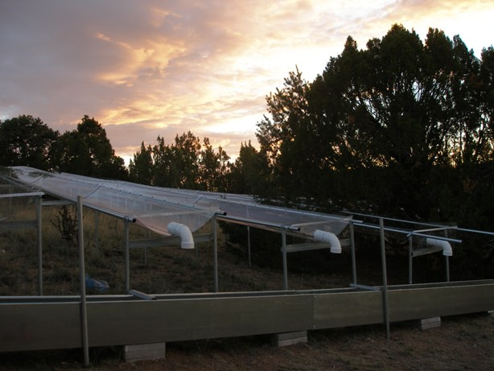

Slide 7
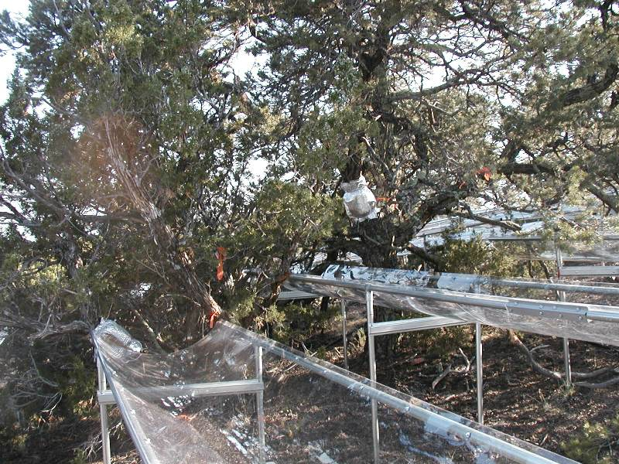

Slide 8
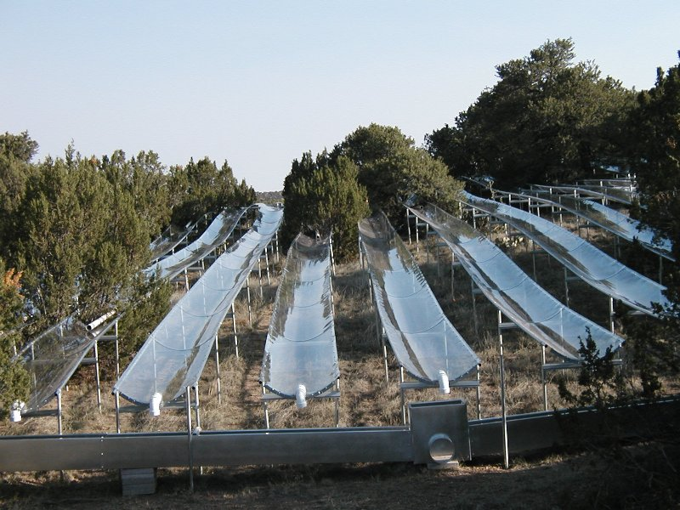

Slide 9
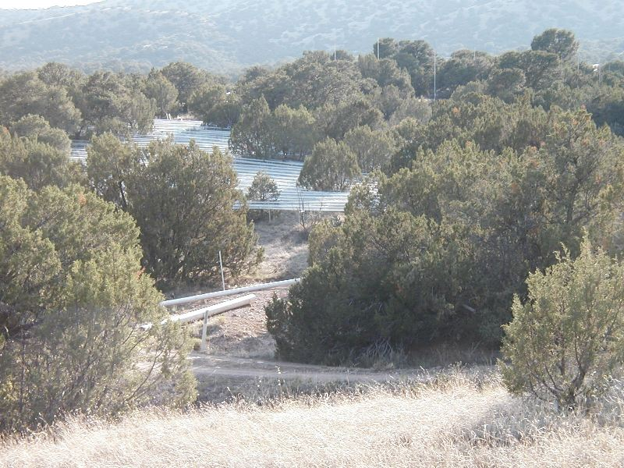

Slide 10
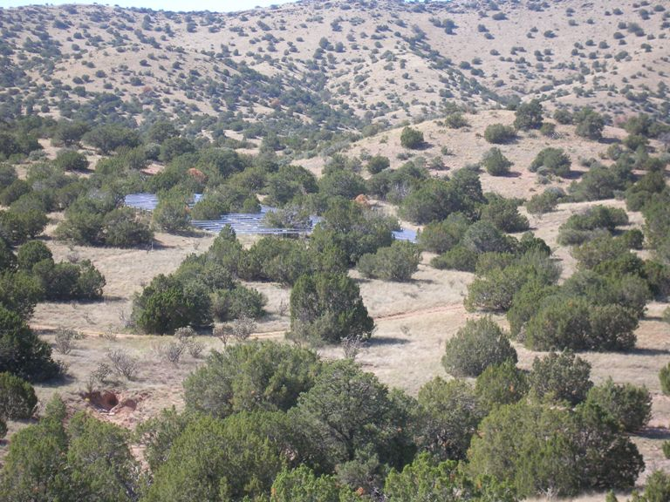

Slide 11
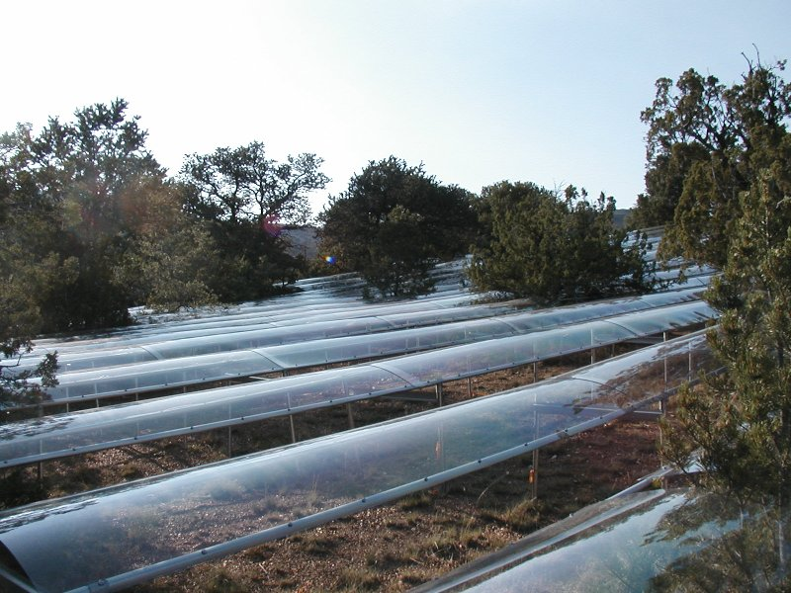

Slide 12
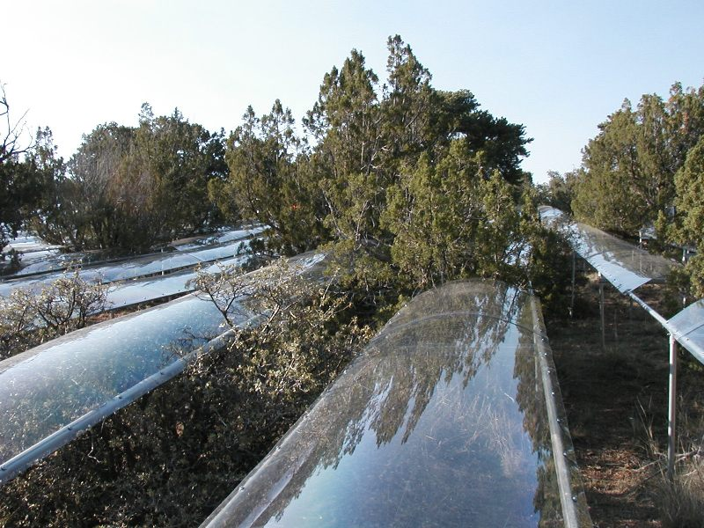

Slide 13
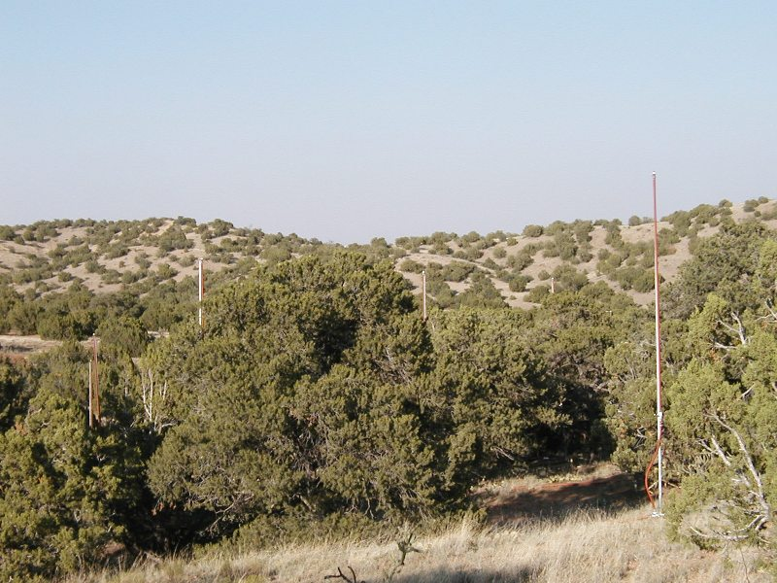

Slide 14
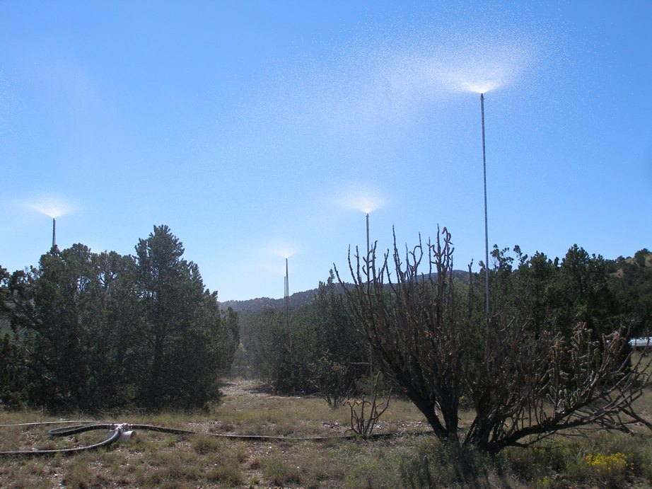

Slide 15
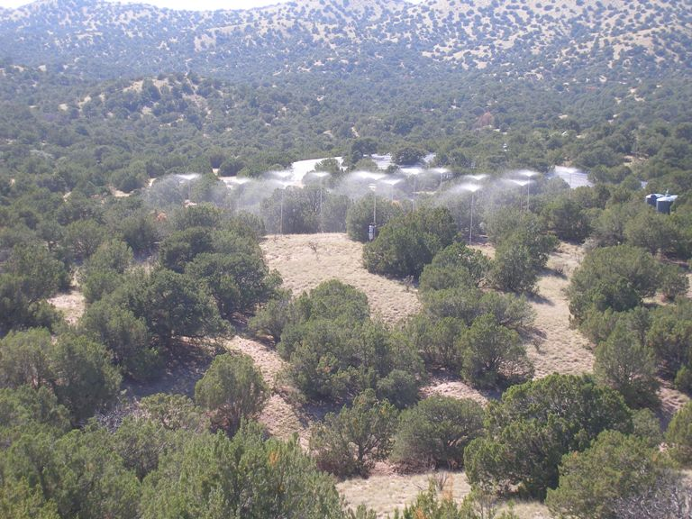

Slide 16
